Slide 1
Progress Report: VISA Communication Tool
Group 64 • 15.02.2017
Wenbo Hou, Chenliang Wang, and Lucien Tamno

Slide 2
Review
Expected delivery
Python Based VISA Communication App
Project Objectives
Coding in Python
Graphic User Interface
Communication Layer
Block Data I/O
Code Complete Feature
Querying Tool
Instrument Operations

Slide 3
Communication
Lucien Tamno
Implementation Read/write:( Interface-OS, Interface-GUI,Other-File)
Integration Module interaction interfaces and bus systems (GPIB, RS232, USB, Ethernet)
Testing Module

Slide 4
Implementation Read/write File
sample code
infile = "myFile.txt"
retrievedFile = open(infile, mode='r', encoding="utf-8")
if retrievedFile.mode == "r":
retrievedFile = (open(infile, 'r') or StringIO("some initial text data"))
elif retrievedFile.mode == "rb":
retrievedFile = (open(infile, "rb") or BytesIO(b"some initial binary data: \x00\x01"))
else:
print("this file is not readable")
exit(0)
for line in retrievedFile:
outfile = line.readall()
outfile.BufferedWriter()
outfile.flush()
retrievedFile.isatty() retrievedFile.close()

Slide 5
Integration Module interaction interfaces and bus systems (GPIB, RS232, USB, Ethernet)
Sample code:rm = visa.ResourceManager()
rm.list_resources()
('ASRL1::INSTR', 'ASRL2::INSTR', 'GPIB0::12::INSTR')
inst = rm.open_resource('GPIB0::12::INSTR')
print(inst.query("*IDN?"))

Slide 6
Testing module
To be Implemented

Slide 7
IDE Configuration
Setup Source Structure
Put Setup instruction
Generate root test script
Try output function
Apply fake query results
Set inline Icon
Upload Icons
01.30.17
01.31.17
02.02.17
02.04.17
02.05.17
Set Software Icon
Commands to acquire key
Related unit tests
Remove extra space in display list

Slide 8
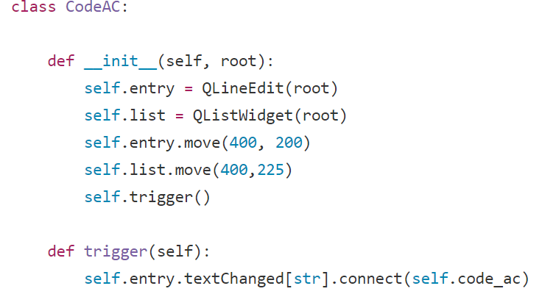
Progress - Code Complete Wenbo Hou
Acquire Key
Active when text is changing
Pass current input to the query function

Slide 9
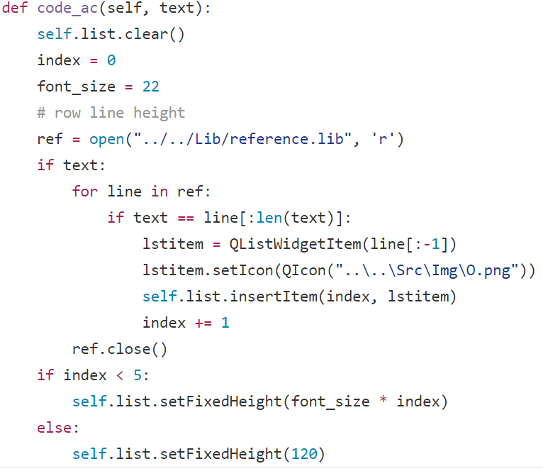
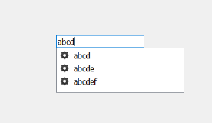
Progress - Code Complete Wenbo Hou
Output Results
Drop List
Icon associated with command
Dynamic List Height

Slide 10
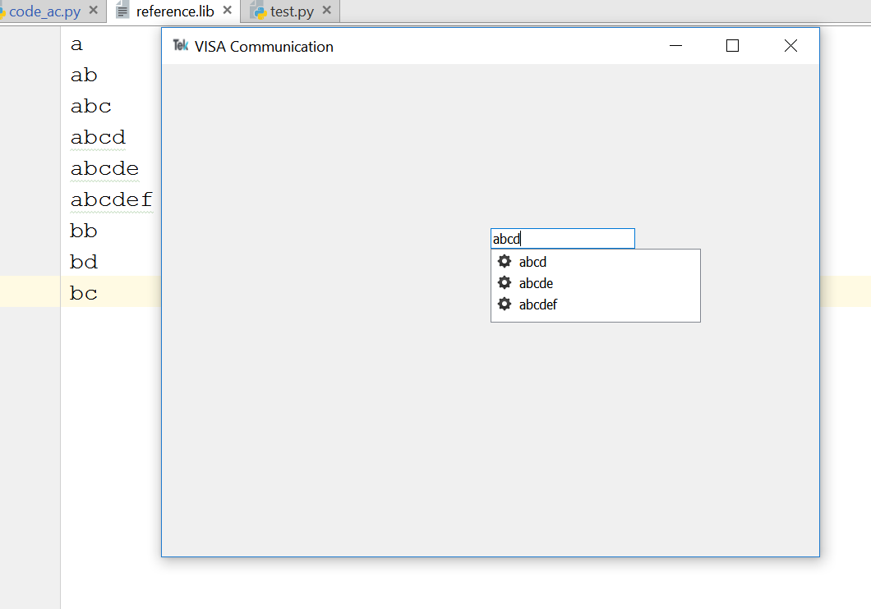
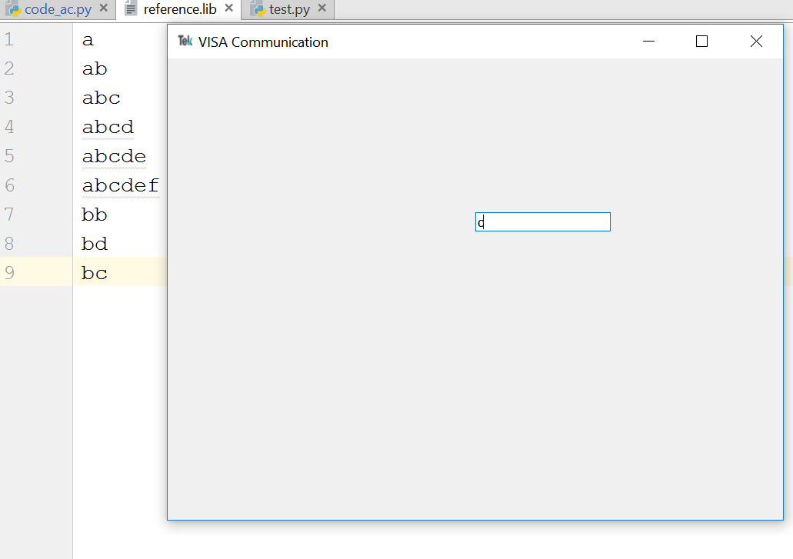
Quick View Wenbo Hou

Slide 11
Next steps Wenbo Hou
Query function in Code Complete
Generate querying algorithm
Prepare documentation
Assign certain icon to a command set
Unit tests and functional tests
Query Tool
Separate display window
Querying algorithm

Slide 12
Goals for next meeting
Fully functional Code Complete feature
Query Tool (alpha version)

Slide 13
3 pieces of whole project Chenliang Wang
GUI Design ------ Almost done
GUI Implement ------ On the way
Function Test ------ Doing soon

Slide 14
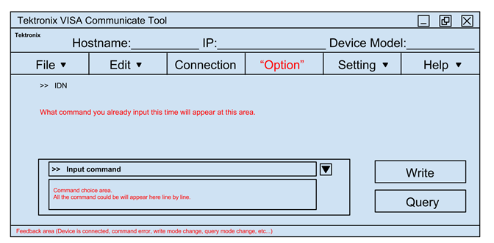
Progress - past Chenliang Wang
GUI Design

Slide 15
Progress - current Chenliang Wang
GUI Implement
Enveriment
Pycharm + Python 3.6 + PyQt 5.71

Slide 16
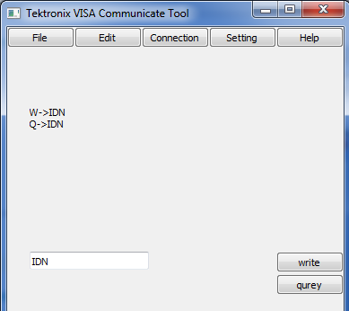


Progress - current Chenliang Wang
GUI Implement
Navigation bar
Send command with query or write.

Slide 17
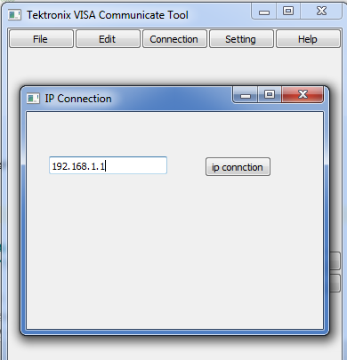

Progress - current Chenliang Wang
GUI Implement
IP connection

Slide 18
Progress - later Chenliang Wang
Function Test
Human Test
Unit Test

Slide 19
Future Plan Chenliang Wang
What I need to do next
Continue other functions.
Organize the code
Modify the UI
Unit Test part by part
Debug

Slide 20
Conclusion

